Slide 1
Morphir
Sharing Business Logic
..across people & technologies

Slide 2
Morphir: Sharing business logic across people and technologies
What is business logic?
The essence of a business application
What’s left after
Business expert view in business expert language
Existing approaches
Share data
Share libraries
Share services

Slide 3
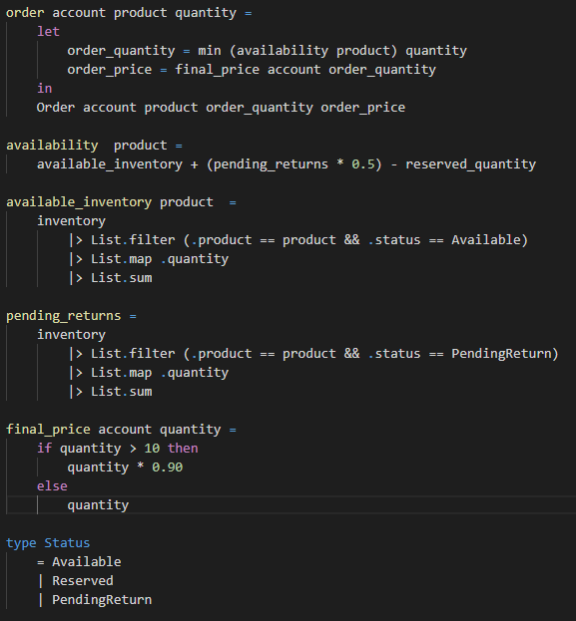



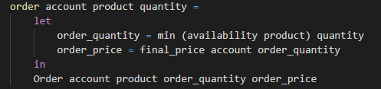
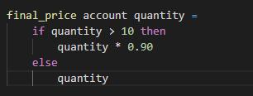

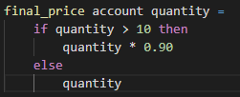
Morphir: Knowledge

Slide 4
Morphir: Agility

Slide 5
Morphir: Benefits
Risk
Evolve technologies without risking core business logic
Increased transparency means fewer bugs
Efficiency
Automate much of development
Agility
Adopt new technologies quickly
Knowledge
Holistic view
Automated documentation

Slide 6
Morphir: More Benefits
Development tools
Testing tools
Metadata: Catalog and Lineage
Audit
Language integration

